Slide 1

Welcome To Our Presentation

Slide 2

Fashion Blog
Submitted By
1.17201093
2.17201106
3.18101075
4.18101076
5.18101060
Submitted To
TANMOY SARKAR PIAS
LECTURER, CSE, UAP

Slide 3
Impacts
These fashion blogs not only provide a platform to the bloggers, but they also bring lots of opportunities their way. We can generate make money from this fashion blog site. Success in e-commerce is determined by laws of conversion , use of conventions and by enabling choice.After this talk , we will have learnt a very concrete approach to obtaining success in fashion e-commerce , illustrated with recent best practices . As we are run ecommerce through fashion blog site.So we are highly encouraged for doing this project.

Slide 4
Purpose
Allow designers and boutiques to place paid advertisements on our blog.
Blogging works as a method for attracting an audience because it provides something of value to them before asking for anything in return
Partner with Designers and Boutiques Owner can Sale the items through website as Vendor.
Can use Google AdSense Monetization.

Slide 5


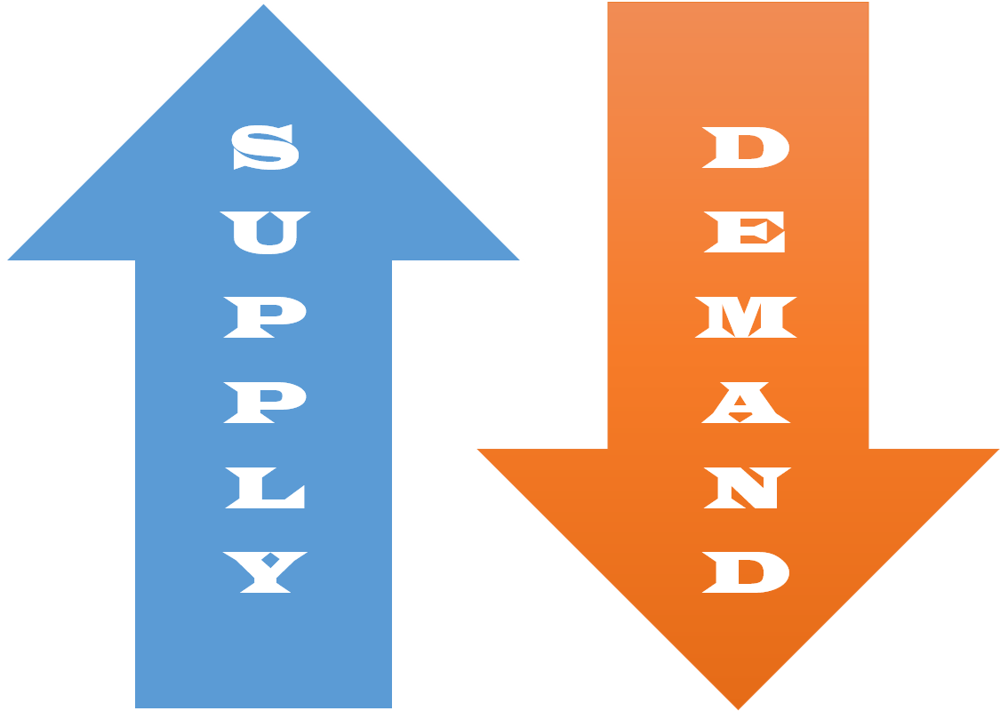
Features
Login Access
Create Account
Sign In Account
Fashion In Trends
User Can Easily Find Out Latest Products with Consumer Review
Print on Demand Service
User Design Customization Panel
Work Opportunity as An Affiliate

Slide 6
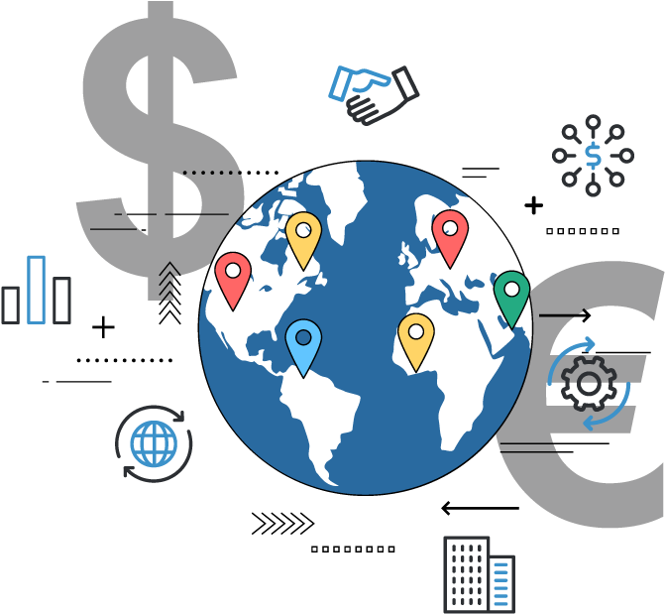

Features
International Payment Gateway
All over the world Online Payment Method (PayPal, Payoneer, VISA) Acceptable
Instant Communication
Member’s Can Get Instant Email Notification of Trending Product with Review

Slide 7



More Uses
Fashion & Lifestyle
Grooming Session
Hair Style

Slide 8
Login Access
User Registration
Sign in Option
Only Registered Member’s Can Access Premium Features Only

Slide 9
Fashion in Trends
Weekly Trending Products Show in Homepage
User can Write Review on Trending Product

Slide 10
Print on Demand Services
Registered Member Can Edit Given Products Customization For Color , Design etc. Before Shipping
Registered Member Can Added New Design and Submitted through Our Website

Slide 11
Payment Gateway
International Member’s can Use Online Banking and Transactions
Local Customer Can Make Online/Offline Payments for Goods

Slide 12
Fast Communication
Registered Member will Get Email for Featured Products
Regular User Get Voucher/Discount

Slide 13
Technology We Used
Language : Python
Framework : Django
IDE : PyCharm
Database : MySQL

Slide 14
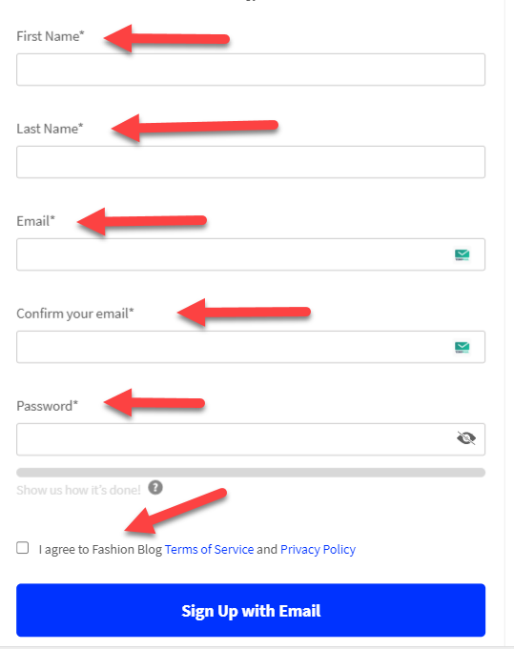
UI Design
Login Access

Slide 15
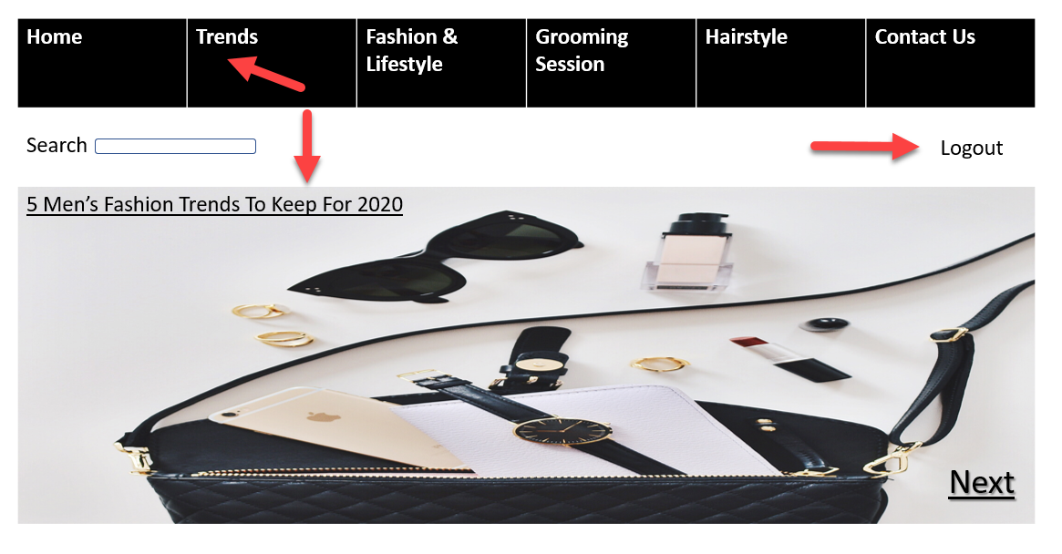
Homepage
Print On Demand

Slide 16
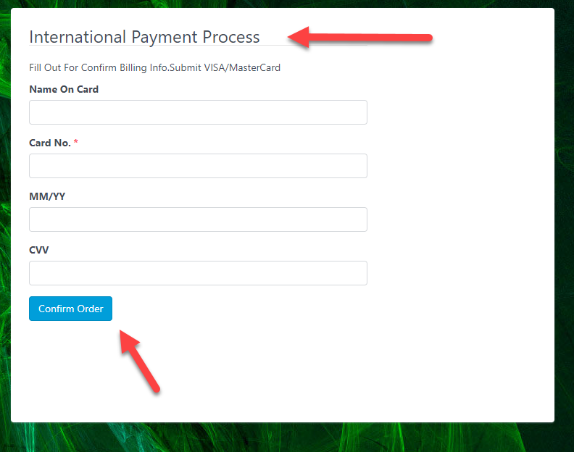
International Payment Gateway

Slide 17
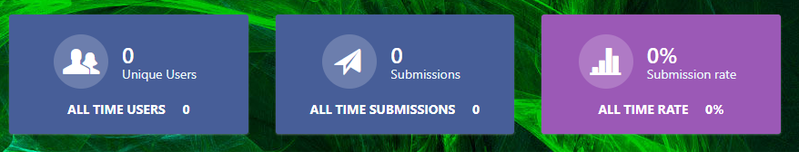
Fast Communication (Email Sender)

Slide 18
Timeline
Planning
Week 1
*Research
*Feasibility study
*UI design
Week 2
Analysis & Study
Week 3 & 4

Slide 19
Development
Week 5 & 6
Implementation
Week 7-10
Development of Database
Week 8-10
Testing (Customer Acceptance)
Week 11
Documentation
& Submission
Week 12-13

Slide 20
Conclusion
We hope this application will help the customer to save their time & provide an easier way to choosing the fashionable instrument, new fashion trend from this system.

Slide 21



